Slide 1
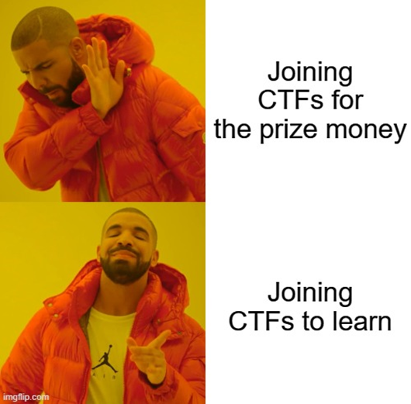
CTF? WTF?
Capture The Flag, Wacky Tech Fiasco (obviously!)

Slide 2
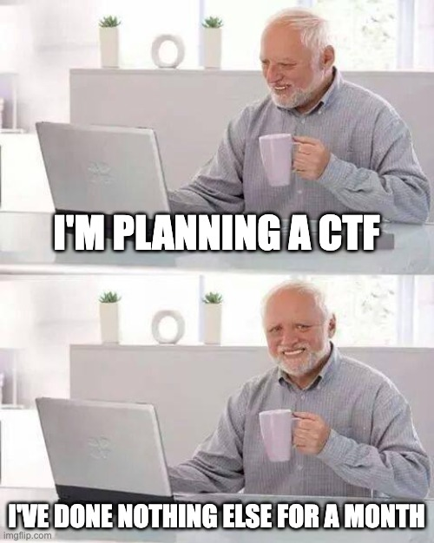
Engaging Challenges in Cybersecurity
A cybersecurity competition where participants solve a variety of challenges to find hidden "flags" within vulnerable systems or applications.
To test and improve skills in various areas of cybersecurity, including cryptography, reverse engineering, web exploitation, forensics, and more.
‘First’ hosted in 1996 at DEFCON in L.A.
Traditional competition or ‘war game’ at hacker conferences or events.

Slide 3
Attack / Defence (Red v Blue)
A variant of competitions where teams compete by both attacking the systems of other teams and defending their own systems from attacks.
This style of CTF simulates real-world cybersecurity scenarios where teams must both exploit vulnerabilities and secure their own infrastructure.
Offensive Operations:
Actively seek out vulnerabilities in the systems of other teams.
Exploits are used to compromise opponent's services, steal flags, or disrupt their operations.
Offensive tactics include reconnaissance, vulnerability assessment, exploitation, and maintaining access.
Defensive Operations:
Teams work to protect their own systems from attacks launched by other teams.
Defensive measures involve patching vulnerabilities, hardening configurations, monitoring for suspicious activity, and responding to incidents.

Slide 4
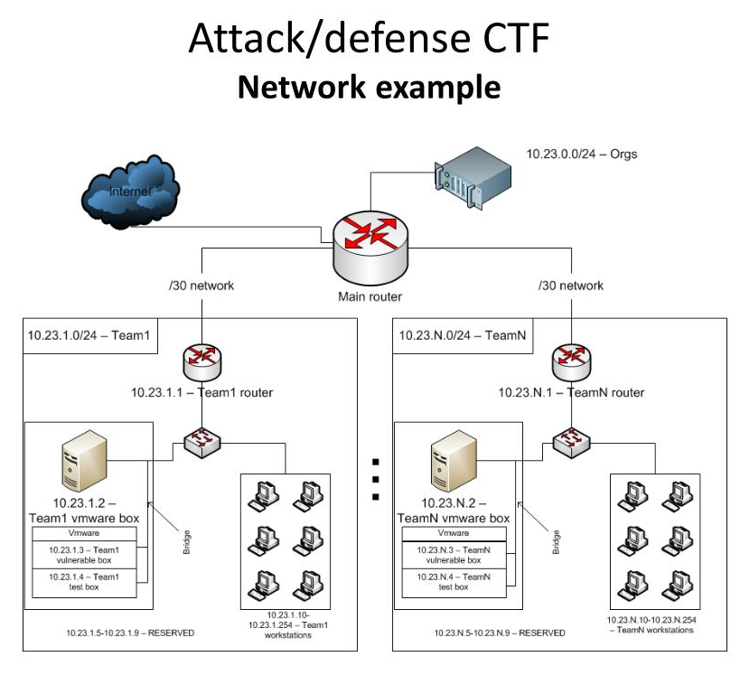
Attack / Defence
Teams must employ strategies to detect and mitigate attacks while maintaining service availability.
Flag Management:
Each team is assigned a set of flags representing sensitive data or system access.
Flags are strategically placed on team systems and must be protected from attackers while being actively sought by opponents.
Teams earn points by capturing flags from other teams while defending their own flags from being captured.
If you’ve done Ethical Hacking or Network Security, you CAN do this!

Slide 5
Jeopardy
A popular format where participants solve a series of challenges across different categories to earn points.
Inspired by the quiz show "Jeopardy," participants select challenges from a board of categories and point values, each representing a different cybersecurity topic.
Challenges are categorized based on various cybersecurity topics such as cryptography, web exploitation, reverse engineering, forensics, binary exploitation, and steganography.
Each category contains challenges of varying difficulty levels, ranging from beginner to advanced.
Challenges are assigned point values based on their difficulty level.
Higher point values are typically awarded for more challenging problems. /s

Slide 6
Jeopardy
Reverse Engineering:
Participants analyse and understand the inner workings of software or systems to uncover vulnerabilities or hidden information.
Cryptography:
Decoding encrypted messages, breaking cryptographic algorithms, or exploiting weaknesses in cryptographic implementations.
Web Exploitation:
Identify and exploit security flaws in web applications, such as SQL injection, cross-site scripting (XSS), or server-side request forgery (SSRF).
Forensics:
Investigating digital artifacts, analysing log files, or recovering deleted data to solve a puzzle or uncover hidden information.

Slide 7
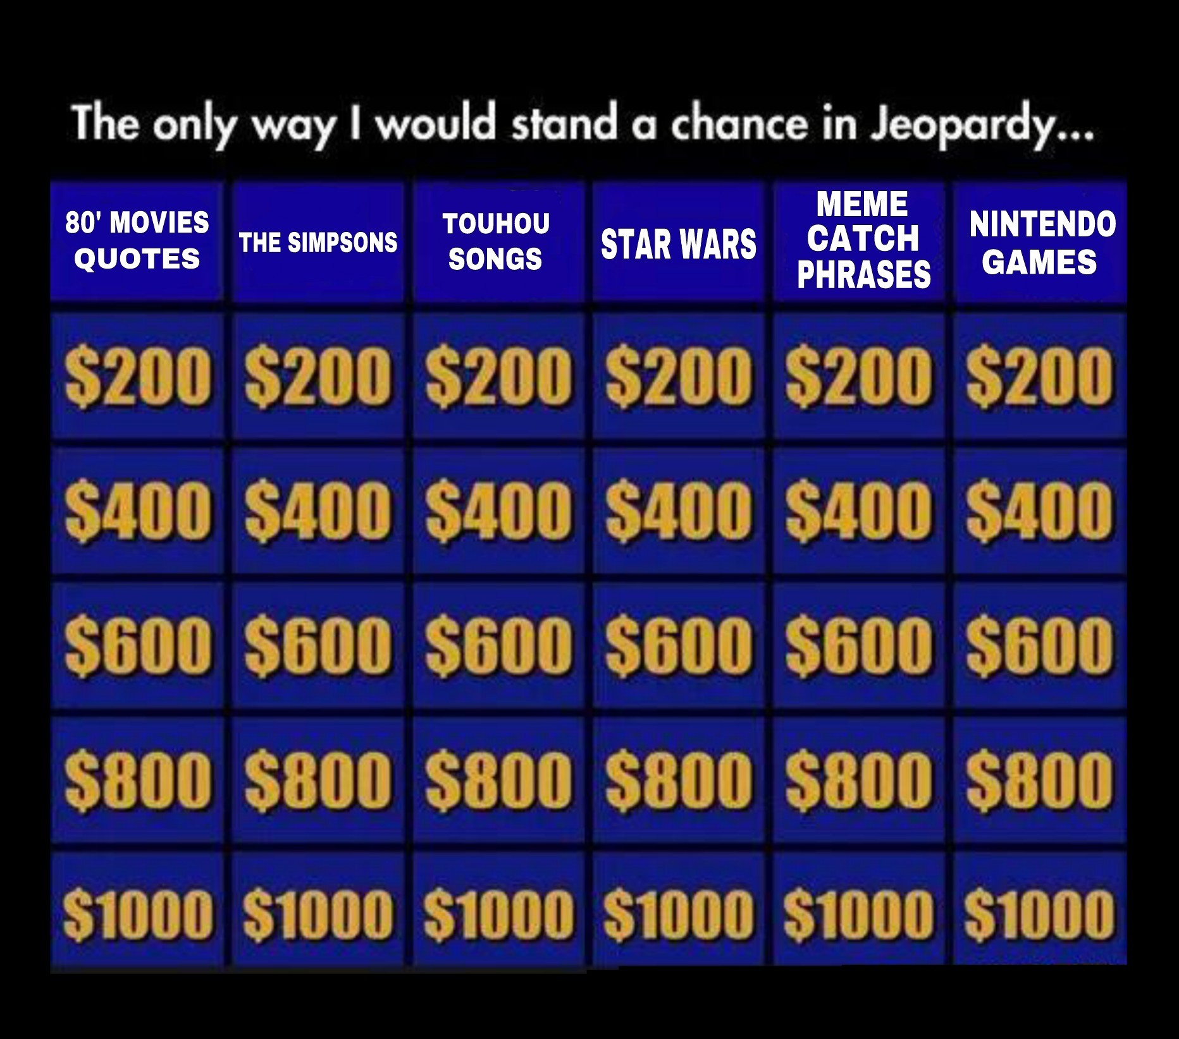
Jeopardy
Binary Exploitation:
Analyse and exploit vulnerabilities in compiled binary programs, such as buffer overflows, format string vulnerabilities, or memory corruption issues.
Steganography:
Extracting hidden messages or data from images,
audio files, or other media using various techniques.
And other types of question
Great.. So…
What does all that actually mean?

Slide 8
Reverse Engineering
Analyse and understand a binary executable to find a password or key that "unlocks" the program.
Disassemble the binary using tools like IDA Pro or Ghidra. Analyse the assembly code to identify how the program validates input. Look for functions related to input validation, encryption, or password checking. Use debugging tools like GDB to step through the program's execution and observe its behaviour.
This feel difficult, assembly code is not something we (RGU) teach… maybe coming in a new module?

Slide 9
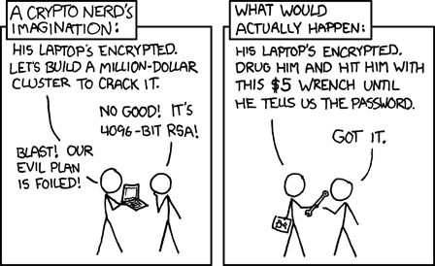
Cryptography
Decrypt a message encrypted using the Caesar cipher, where each letter is shifted a certain number of positions in the alphabet.
Try all possible shift values (0-25) and analyse the decrypted text for meaningful words or patterns. Utilize frequency analysis techniques to identify common letters or digraphs in the English language.
Apply automated tools or scripts to aid in the decryption process.
You could hand-crank this… but the point (and the amount of data?) would be to python it to get a result quickly. You CAN do this one!

Slide 10
Web Exploitation
Exploit a web application vulnerability to retrieve sensitive information from a database using SQL injection techniques.
Identify input fields vulnerable to SQL injection, such as login forms or search queries.
Craft SQL injection payloads to manipulate SQL queries and extract data from the database. Utilize tools like SQLMap or Burp Suite to automate the detection and exploitation of SQL injection vulnerabilities.
If you’ve done any web dev or web security, you CAN do this one!
It could be something else, not just SQLi, cookies? Session hijack?

Slide 11
Forensics File Analysis
Analyse a provided file (e.g., disk image, packet capture, or memory dump) to extract hidden information or solve a puzzle.
Use forensic tools like Autopsy or Volatility to examine the contents of the file and recover relevant artifacts. Look for timestamps, file metadata, or embedded clues within the file.
Apply data carving techniques to extract hidden files or data fragments. Analyse file headers and footers to identify file types and extract meaningful information.
I teach this, CY4! Autopsy and volatility! But depending on the data you’re given, maybe network capture is an easy one too.

Slide 12
Binary Exploitation
Exploit a buffer overflow vulnerability in a binary executable to gain control of the program's execution flow.
Identify input fields susceptible to buffer overflow, such as user input buffers or function arguments.
Craft payloads to overflow the buffer and overwrite the program's return address to redirect execution flow to a desired location. Utilize tools like GDB or PEDA to analyse memory layout and debug the exploit process.
Sounds difficult to me, but maybe if you’ve a software dev background it means more to you? (no harm in trying though)

Slide 13
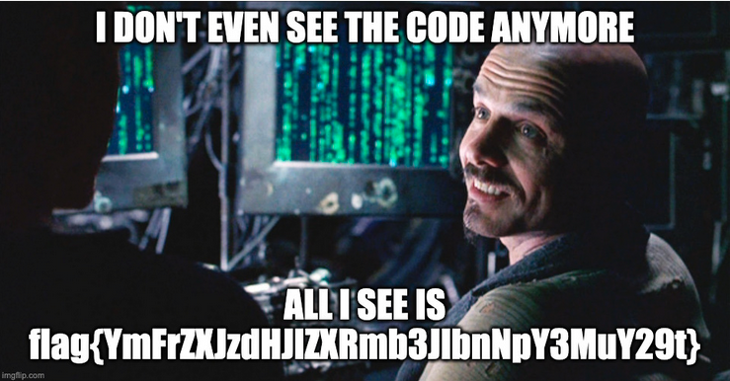
Steganography
Extract a hidden message or data embedded within an image using steganography techniques.
Analyse the LSB (Least Significant Bit) of each pixel in the image to detect hidden data. Utilize steganography tools like Steghide or OutGuess to extract hidden payloads from the image.
Experiment with different steganographic algorithms and parameters to uncover the hidden message.
I teach this, CY4! So, if I can figure it out you CAN.

Slide 14
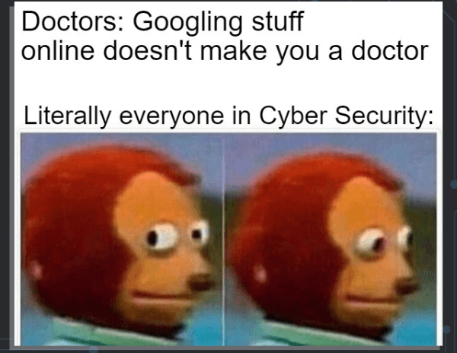
Key Skills
Problem Solving:
Ability to analyse complex problems and
develop creative solutions.
It’s not an exam, you can use Google!
Critical Thinking:
Capacity to think logically and strategically to overcome challenges.
Technical Knowledge:
Understanding of various cybersecurity concepts, tools, and techniques.
Or learn it, try things, follow along with others in your team.
Collaboration:
Working effectively in teams to tackle challenges and share knowledge.
Persistence!:
Willingness to persevere through difficult problems and learn.

Slide 15
Tips for Success
Practice Regularly:
Engage in continuous learning and practice by participating in online platforms, workshops, and local/online competitions.
Work as a Team:
Leverage the strengths of team members and collaborate effectively to solve challenges.
Document Your Process:
Keep detailed notes and document your approach to solving challenges for future reference.
Think Outside the Box:
Be creative and explore unconventional solutions to tackle difficult problems.
Have Fun? – It’s not for a grade or a job interview, just try it.

Slide 16
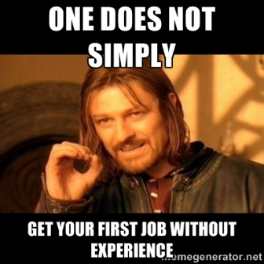
Taking Part in One
BYOD:
Bring your own device. (Probably)
Cables, extensions, batteries, phone, headphones.
Follow the Rules
Never DoS/DDoS
Don’t brute force
Don’t writeup/blog the challenge during the challenge
Flags ‘normally’ in a predictable style (CTF-XYZ{flag_here})
Submit the flag to the scoreboard (you can play tactically here too ☺ )
Pace yourself, could be 24/48 hrs.
Be comfortable, bring snacks!

Slide 17

RGU students…
Organise a group/team and come pester me to enrol you.
Before 4th March!
CTF Events : CTFtime.org
osu!gaming CTF 2024 | 01 March, 17:00 UTC — 03 March 2024, 17:00 UTC
GCC CTF 2024 | 01 March, 20:00 UTC — 03 March 2024, 20:00 UTC
Pearl CTF | 08 March, 12:00 UTC — 09 March 2024, 23:59 UTC
CTF Handbook : ctf101.org

Slide 18
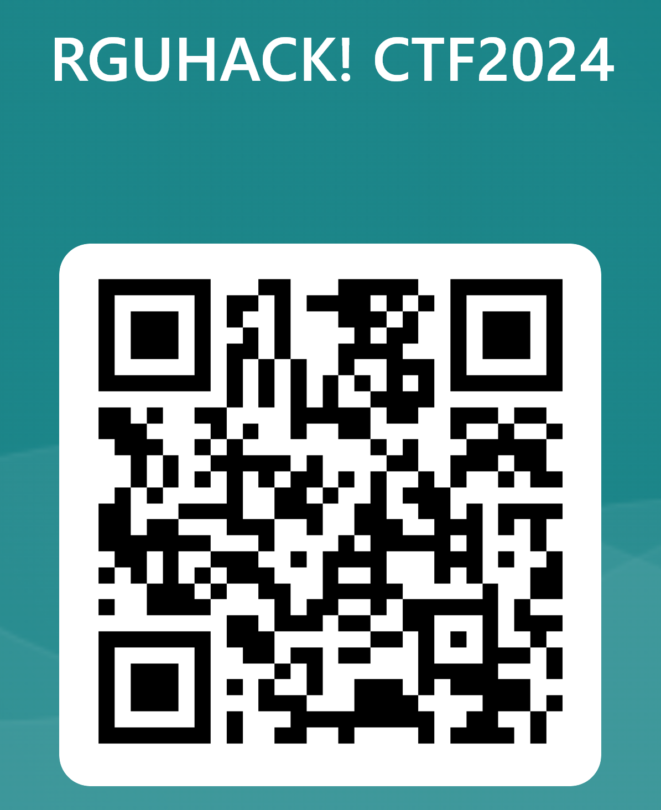
Just for fun!
No prizes.. Maybe a bag of Haribo if I see you giving it a try!
https://forms.office.com/e/JQL4QNzNz6

